Slide 1
2022 NAPAA Sorority 101

Slide 2
2022 NAPAA Sorority 101
Reasons for Joining a Sorority
General Terminology
Resources
Greek organizations
Resumes, Recommendations and Legacies
Grades
Cost/Expenses
Recruitment Process and Virtual Recruitment
Bids
After Recruitment
Questions

Slide 3
Why Join a Sorority
Meet People and Develop Friendships
Support Network
Social Events
Campus Involvement
Develop Leadership Skills
Develop Professional Skills
Academic Advice and Support
Alumnae Connections

Slide 4
Recruitment/Sorority Terminology
Bid
Bid Day
Continuous Open Bidding (COB)
Membership Recruitment Acceptance Binding Agreement (MRABA)
New member
Potential New Member (PNM)
Preference round
Quota
Recruitment
Recruitment counselor
Total
Alumna/Alumnae
Badge
Big sister
Collegiate chapter
Chapter meeting
Collegiate member (also often referred to as an Active)
Initiation
Membership education
Panhellenic
Philanthropy
Ritual
Symbols

Slide 5
Resources
https://www.npcwomen.org/ National Panhellenic Conference the governing body of the traditional sororities
https://thesororitylife.com/ sections for potential members, current members, and family and friends
https://www.nashvillepanhellenic.org/ section on recruitment
College Greek life pages where you’ll find registration forms, information on recruitment schedules, what to wear information, etc.
Social media

Slide 6
Greek Letter Organization Governing Bodies
NPC – National Panhellenic Conference (women’s organizations)
NIC - North American Interfraternity Conference (men’s organizations)
NPHC – National Pan-Hellenic Council (both men and women’s organizations)
NMGC – National Multicultural Greek Council (both men’s and women’s organizations)
NALFO - National Association of Latino Fraternal Organizations (both men and women’s organizations)
NAPA – National APIDA Panhellenic Association (both men’s and women’s organizations)
And various other music, professional, and local and non-affiliated national organizations.

Slide 7
Resumes, Recommendations, and Legacies
Resumes
Social not job
Include name, address, birthdate, GPA, ACT/SAT scores
Emphasis on activities for the 4 years of high school:
Academic awards
leadership roles
Clubs
Sports
Other activities
After school and summer employment
Family Member Greek Affiliations

Slide 8
RECOMMENDATIONS/REFERENCES
Letters of recommendation are optional. They’re nice but not required.
Letters of recommendation are the responsibility of the sorority not the PNM.
Most NPC groups still accept letters of recommendation. Only one, Phi Mu, will not accept them.
If the PNM decides to solicit letters of recommendation reach out to family friends, teacher, school counselors, place of worship leaders to see if any of them are alumnae of Greek organizations.
If the PNM is asking someone to write a letter or recommendation please provide them with a picture, social resume, and academic transcript. Most of the NPC organizations have an electronic form that they prefer to have submitted but check with the alumna and if her organization doesn’t please provide an addressed postage paid envelope.
Several will now accept letters of recommendation from someone who knows the PNM best; teacher, school counselor, coach, etc.
If you want a letter of recommendation and do not have any other contacts please contact NAPAA. We have a form on our web site where a letter can be requested.
Please check with your college panhellenic for due dates for letters of recommendation.

Slide 9
Legacies
Each sorority defines its legacies slightly differently but for most it is some variation of the daughter, granddaughter, or sister of an initiated member in good standing of the sorority.
While all the NPC sororities love our legacies, most are no longer giving preferential treatment to the legacies.

Slide 10
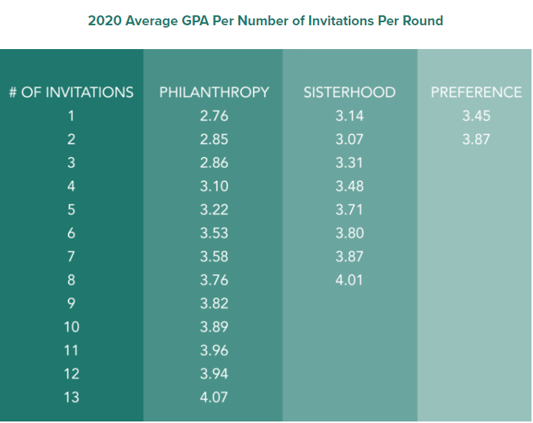
Grades
Each university or college will have a minimum GPA for recruitment
Each sorority will have a minimum GPA for membership

Slide 11
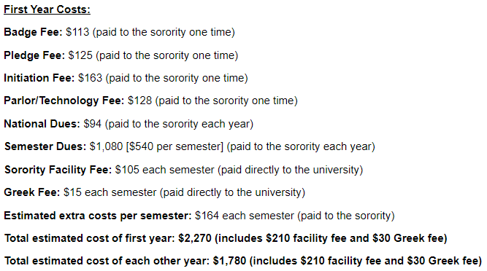
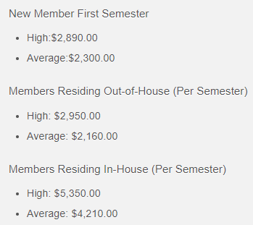
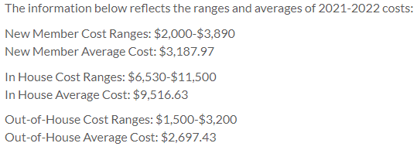
Sorority Expenses
Sorority cost is going to vary from campus to campus and will depend on what is included.

Slide 12
The Recruitment Process
Each collegiate panhellenic will publish a schedule in their recruitment guide.
Normally 4 rounds of parties: Go Greek, Philanthropy, Sisterhood, and Preference.
On most campuses Philanthropy, Sisterhood, and Preference are invitation only.
Conversation topics:
How do you balance sorority life with academics and other activities?
Why did you join a sorority?
What other campus activities are members of your sorority involved in?
What are some of the chapter sisters majoring in?
How often do you participate in community or philanthropy activities?
What are you social events like?
(if there is a house) What is it like living in the house?

Slide 13
Bids/Bid Day
After the Preference round you will sign a
Membership Recruitment Acceptance Binding Agreement (MRABA): This is a one-year binding agreement signed by a potential new member (PNM) when ranking chapters after preference round of recruitment. A PNM agrees to accept a bid from any chapter she lists on her MRABA, with a maximum of two listed. If a PNM receives a bid to a sorority she lists and declines it, she is bound to it for one year or until the next primary recruitment period, meaning she cannot accept a bid to any other organization during this period. If a PNM signs an MRABA and does not receive a bid, she is eligible for continuous open bidding or snap bidding.
On Bid Day
You’ll meet at a predesignated spot where your recruitment counselor will give you your bid. You’ll then make your way to either your new sorority’s house or other site.

Slide 14
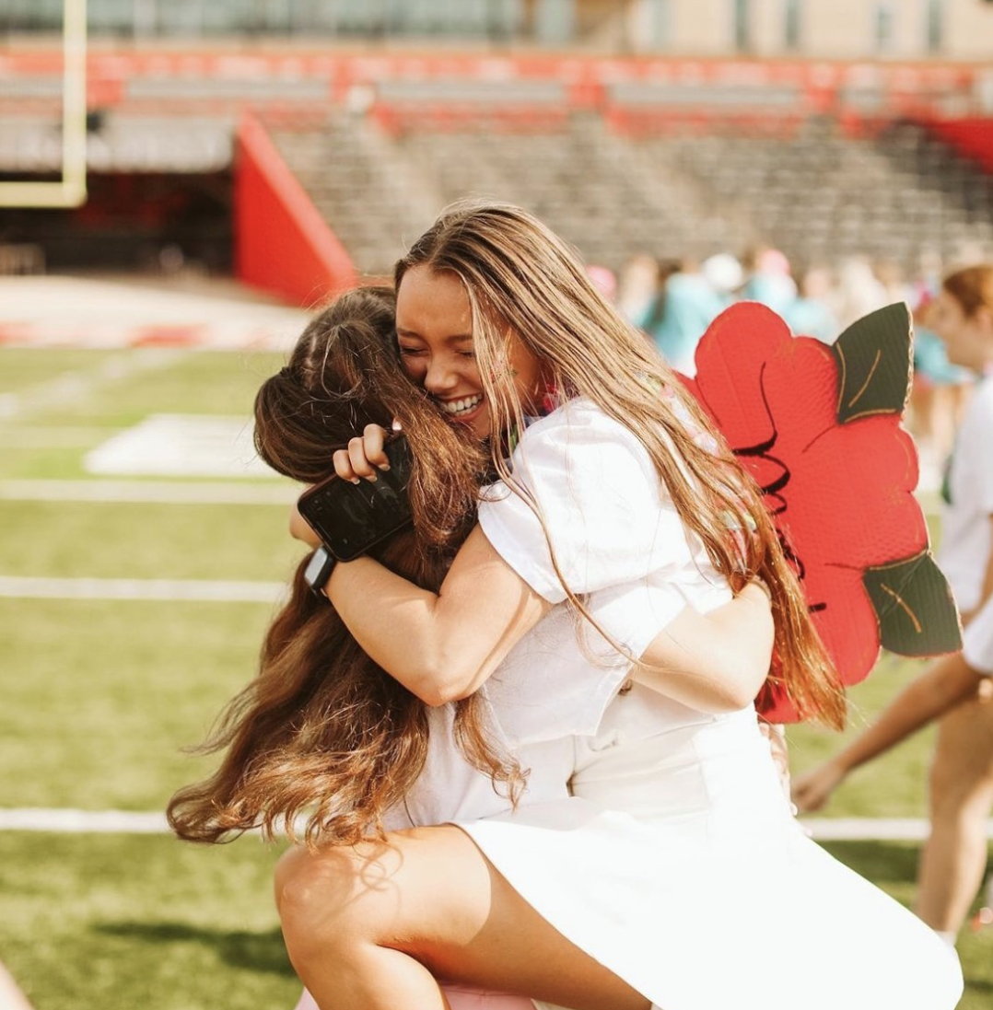
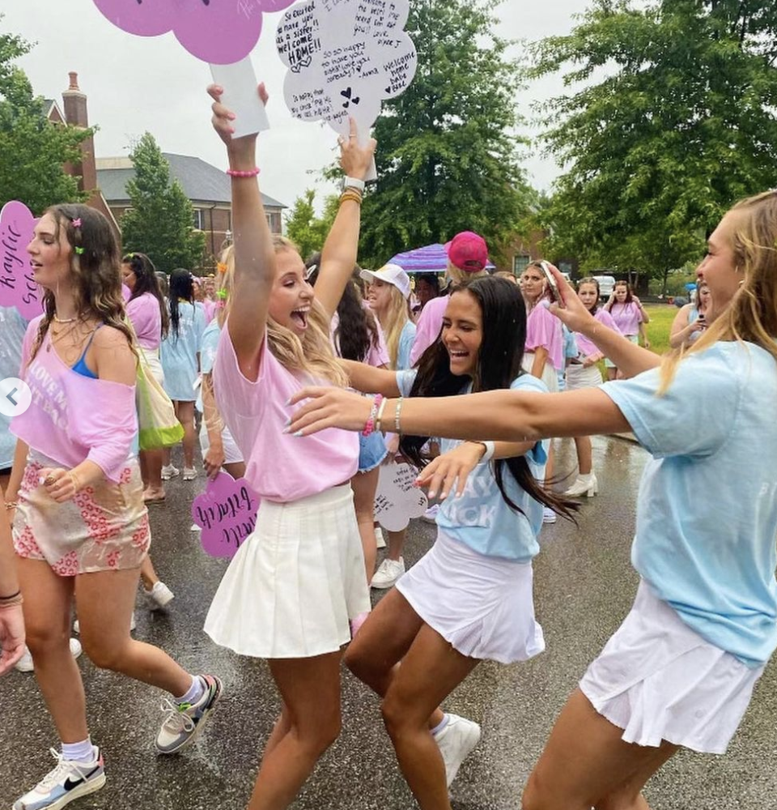
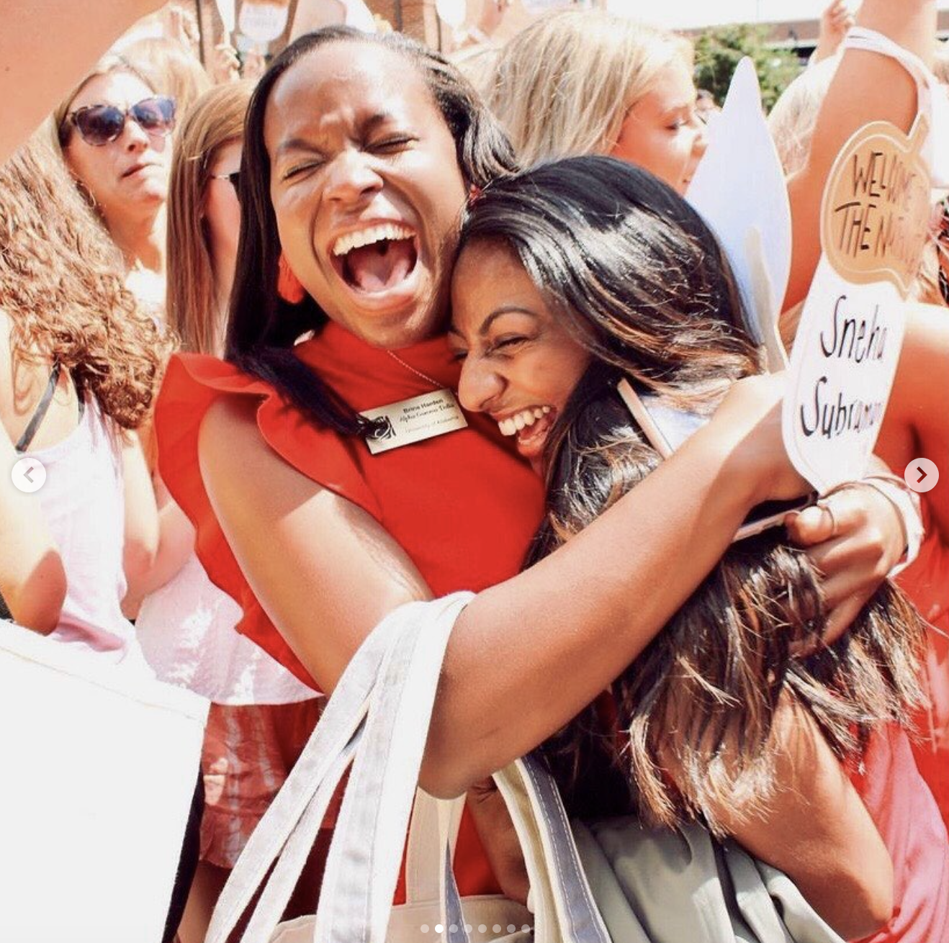
Bid Day!

Slide 15
After Recruitment
On Bid Day you’ll meet all of your new sisters at the sorority house or other designated campus site for a celebration to welcome you to the sisterhood.
New Member Period
Learn the history and traditions of the sorority and responsibilities of members.
Sisterhood events
New member retreats
Big/Little Sis
Initiation – where you learn all the secret stuff!

Slide 16
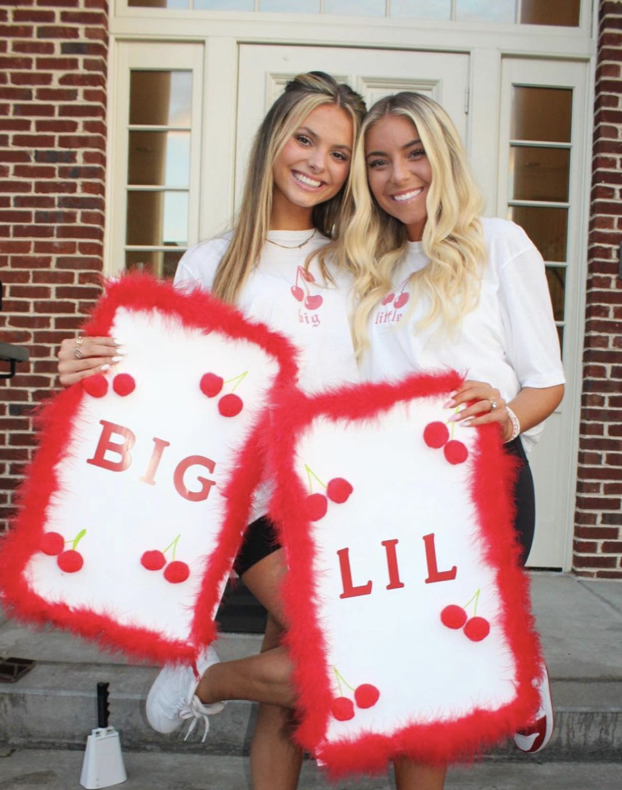
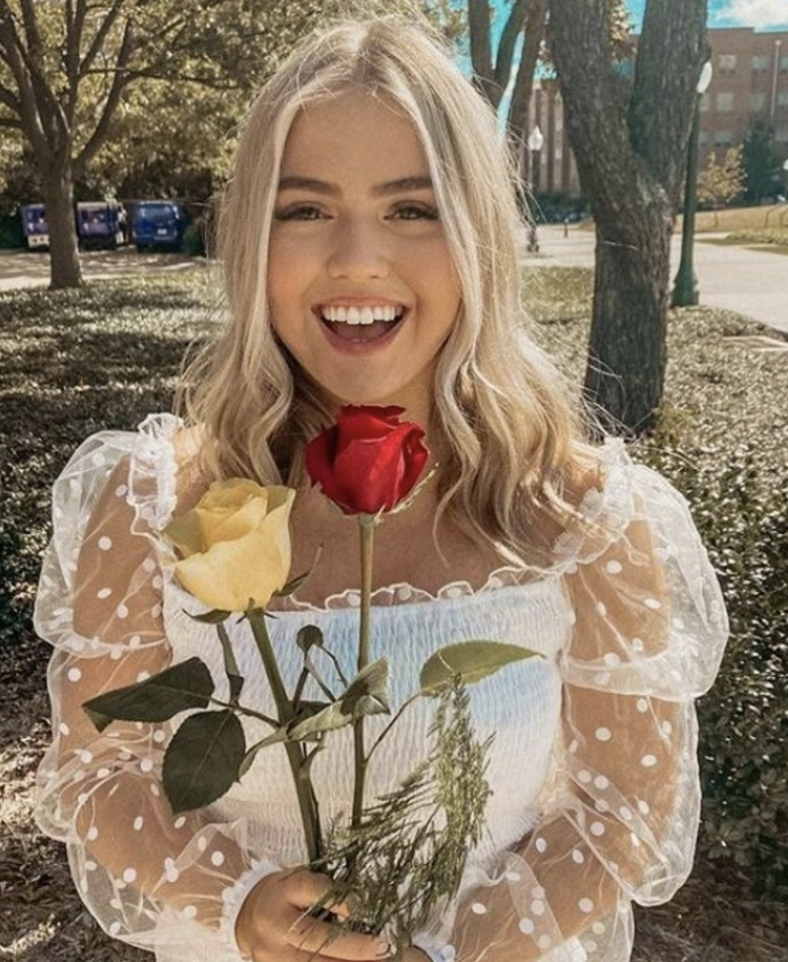
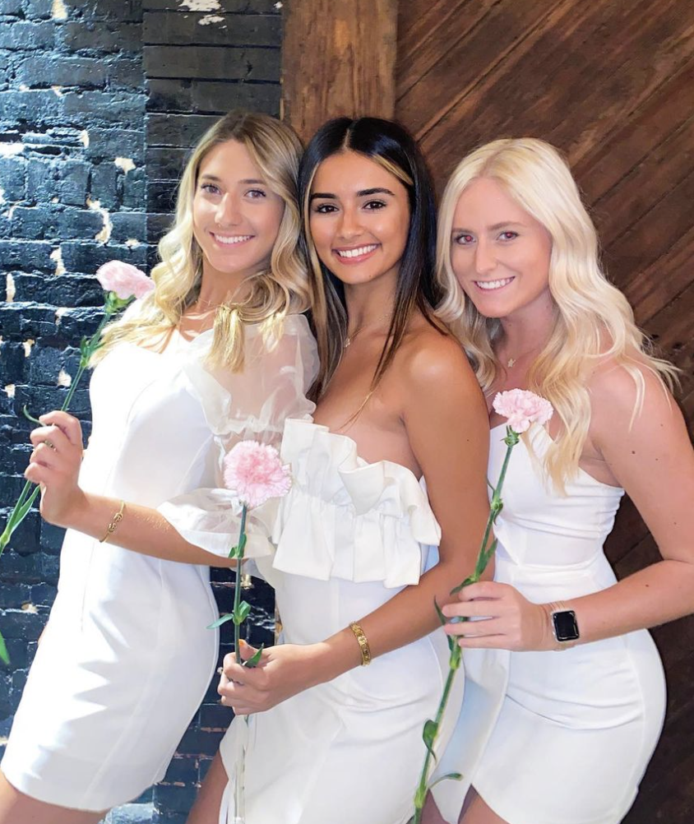
After Recruitment
Sisterhood Events
Big Little
Initiation

Slide 17
Questions/Comments

